Slide 1
Future & Existing
Data Playbook

Slide 2
Customer Lifecycle
Different stages of a customer Lifecyle defined based on their purchase behavior with Home depot
HH Lifecycle Stage |  |  | Definition | Size
NON THD | Prospects Audience who didn’t make a purchase with home depot | Neustar Prospects | Prospect customers who are in the Neustar prospect file | ~ 7M
THD Shoppers | New | Acquired | A customer who has never made a purchase prior to the current year period (no purchase in the last 7 years) | ~1.5M
 |  | Reactivated | A customer who made a purchase in the current year, no purchase in last year, and made one or more purchases in the year prior to last year | ~ 5M
 | Existing A customer who has made a purchase in both the current year and last year | Stay-in | Customers who stay-in their place and would like make upgrade/maintenance/refresh their homes | ~36M
 |  | Movers | Customers who are moving/moved to a different homes ( obtained from 3P data )
 |  | At-Risk | Customer At-risk/Churn Model
 | Inactive | Inactive | A customer who made at least one purchase last year, but none in the current year | ~ 12M
 |  | Lapsed | A customer who did not make a purchase in the last two-year period, but made purchase three years ago | ~ 7M
 |  | Dormant | A customer who made purchases prior to last three years, but not in the current 3 years | ~ 14M

Slide 3











Future and Existing | Audience definitions
Future - Prospects
Existing - Stay in
Existing - Movers
Home Maintenance
Home Refresh
HHs targeted weekly : 1 M
ECRs targeted
weekly : 3.5 M
HHs targeted weekly for both HMN and HRF: 4M each
Audience segment consisting of individuals highly likely to make their first purchase at Home Depot. This group is identified using 2P and 3P data, browsing behavior, and demographic insights across various customer segments.
Objective :
Connect through relevant project content based on generational and multicultural insights x life stages:
Homeowners
Change consumer perceptions and position THD as exciting place to shop
Diagnostic : Awareness, Reach, CTR, Site Visits
Movers : Individuals who are moving or will be moving to their new homes often require packing/transportation, to set up their belongings in their new homes identified by 3P data sources
Objective : To keep the active audience engaged
Home Maintenance : projects that often require significant time and investment, such as maintenance and repair operations
Home Refresh: Small weekend refreshment projects that create a big impact, like interior painting, wallpaper
Segments under movers
Pre-Move | At-Move
3P Data sources
Audience Composition
Porch
Pre-Move : 0-43 days from Inspection date
At-Move : 44th -134th day from inspection date
Core Logic
Pre-Move : 90 days from list date
At-Move : 90 days from close date
IDM & NCOA
Pre-Move : 90 days prior move date
At-Move : 90 days from the move date
Deterministic– Audience determined by heuristic rules (Browse signals for the past 1 month considering 1P data - Keywords, PIP/PLP, Quotes, Leads, Guides )
Probabilistic– Audience identified by Data Science Models (Purchasers with a propensity to buy in the anchor classes for the selected projects)
Diagnostic : Anchor Sales, IR by Dept & Class

Slide 4
Existing | Project to Class/Sub-class mapping
Pod | Level | Project | Anchor Classes/Sub-classes
HMN | Class | Caulking/Insulation | INSULATION-SFI,INSULATION,CAULKS
 |  | Roofing | ROOFING
 |  | Storage&Org | ORGANIZATION,MOVING & GARAGE ORG,STORAGE BUILDINGS,INSTALLED STRUCTURES
 |  | Cleaning | SOLVENTS/REMOVERS/CLEANR,WET DRY VACS,CLEANING,PRESSURE WASHER,FLOORCARE
 |  | Heating | PORTABLE HEATING
 | Sub Class | Gutter | S/O GUTTER SYSTEMS,VINYL GUTTER,GUTTER ACCESSORIES,METAL GUTTER
 |  | Caulking/Insulation | CAULK GUNS,SF&I INSULATION
 |  | Roofing | BEHR ROOF PAINT,ROOFING NAILS,PNEUMATIC ROOFING NAILER,CORDLESS ROOFING NAILERS,FRAMING & ROOFING COMPRE
 |  | Weather Striping | WEATHER STRIPPING
 |  | SH_THERMOSTATS | THERMOSTATS
 |  | Cleaning | DRAIN OPENERS/CHEMICAL,POOL CHEMICALS,PRESSURE WASHER ACCESS
 |  | Heating | CENTRAL HEATERS,ELECTRIC HEATING,GAS WALL HEAT,PATIO HEATERS,GAS WALL HEATERS,POOL HEATERS
HRF | Class | Outdoor entertainment Q4 | PORTABLE HEATING,EXTERIOR LIGHTING,FIRE,GRILLS,PLANTERS,PATIO FURNITURE,DECORATIVE HOLIDAY,OUTDOOR RECREATION
 | Sub Class | Outdoor entertainment Q4 | S/O RUGS,SCATTER RUGS,BAY STOCK RUGS,TABLE STOCK RUGS,INDOOR/OUTDOOR RUGS,OUTDOOR LIVING KITS,OUTDOOR FIREPLACE,DINING,DINNERWARE, S/O FIBERGLASS PATIO DR,ALUM CLAD PATIO DOORS,COMPOSITE PATIO DOORS, WOOD PATIO DOORS,S/O VINYL PATIO DOORS,REPLACEMENT PATIO SCRNDR, VINYL PATIO DOORS, FIBERGLASS PATIO DOORS,ANDERSEN PATIO DOORS, S/O STEEL PATIO DOORS,STEEL PATIO DOORS,DECORATIVE PILLOWS, SYNTHETIC PILLOWS,KITCHEN & DINING FURN.
* Above are the projects for 2025Q4
>> HMN & HRF Project – Class/Sub class mapping <<

Slide 5


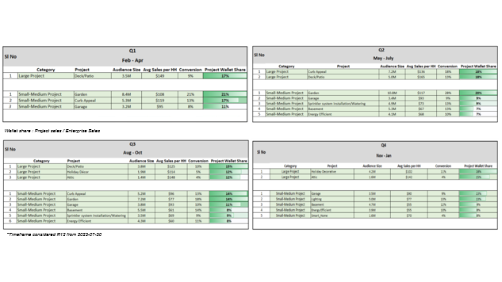
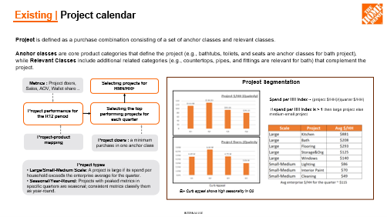
Existing | Project Calendar
How to identify projects for each quarter ? >>
A structured view of project doers and their purchasing behavior over time, typically analyzed on a seasonal or quarterly basis. It helps to understand the behavioral pattern of the different audience segments ( homeowners, renters, movers) , the kind of projects they undertake, and when these projects occur (Seasonality trends), enabling them to identify patterns and optimize marketing strategies
Project doer qualification criteria : At least one purchase in anchor class/sub-class
>> Project calendar <<

Slide 6
Home Refresh & Home Maintenance | Projects
Home Maintenance projects are necessary to ensure the structural integrity, safety, and functionality of a home. These tasks often require significant time and investment but help prevent costly repairs in the long run.
Home Refresh projects are about enhancing the home’s appearance and functionality without major renovations. These are typically smaller, more affordable projects that can be completed over a weekend or in a short timeframe.
Projects for Home maintenance and Home refresh
Home maintenance
Home refresh
2024 - Q2 | 2024 - Q3 | 2024 - Q4 | 2025 - Q1
Storage & org Cleaning Energy efficient HVAC Air filter Water filter Garden Outdoor maintenance | Storage & org Cleaning HVAC Smart home thermostat Outdoor maintenance Curb Appeal Gardening | Gutter Roofing Weather stripping Heating Caulking/Insulation Cleaning | Organization Storage Cleaning Energy efficient (Smart home) Clean air and water OM (Lawn & OPE)
Deck and patio Interior paint Interior wallpaper | Outdoor entertainment Interior paint Interior wallpaper | Outdoor Entertainment Q4 | Interior Paint Bath Outdoor patio Interior wallpaper

Slide 7

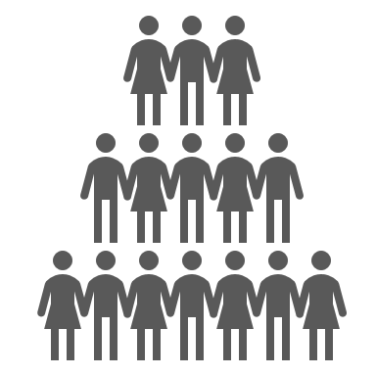




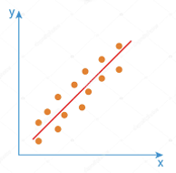
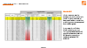
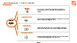
Home Maintenance & Home Refresh | Model scoring
Model Framework
OOTV Stage 1
Classifier
OOTV Stage 2
Regressor
OOTV Combined
Transactions
Sample OOTV >>
Clickstream
Stage 1
Stage 2
Pod
Response Prediction Model
THD
Spend Prediction Model
Demographics
Features / Signals / Input Data Variables
Top 5% Consumers Selected (~2M)
(rank ordered by Expected
THD $ value)
All R12 Active Consumer
Base ~ (35-40M)
Target Variable =
Purchase at least 1 Anchor Product in next 30 days
Target Variable =
THD (enterprise) spend given likelihood of doing a project, in the next 30 days
Scored Consumers
Expected Purchase Value =
Probability of Doing a Project X Predicted THD Spend
* CLV suppression is applied at the end after having the ensembled scores for the existing base
Sample Features ^^
Example
Customer | Pod Response Probability | Predicted THD Spend Value | Expected Purchase Value | Priority Rank
Xyz | 90% | $ 50 | 0.9 x $50 = $45 | 2
Abc | 70% | $ 100 | 0.7 x $100 = $70 | 1
NOTE:
Ex- for Q4
1. Audience Universe: Existing ( R12 and R13-R24 ) Consumers excluding Movers
2. Model Building Time frame : Nov 2023 to Oct 2024
3. OOT Validation Timeframe: Nov 2024
4. Qualifying criteria: Project Doer is someone who has purchased in 1 Anchor class
5. THD Value: Given that a HH has a high likelihood of undertaking a project among the HMN/HRF projects, how much is he/she going to be spending at enterprise

Slide 8
Home Maintenance & Home Refresh | Deterministic signals
Existing consumer base ~ ( 35M - 40 M )
TOTAL DISTINCT
~ 6.5 M
PLP
( 1 Month )
~ 4.4 M
PIP
( 1 Month )
~ 3.8 M
LEADS
( 1 Month )
~ 3 K
QUOTES
( 1 Month )
~ 190 K
GUIDES
( 1 Month )
~ 40 K
KEYWORDS
( 1 Month )
~ 1.7 M
Pod - Home Refresh, Time frame – Q2 2024
All Browsing Footprints by Consumers in the past 1 month
PIP : Product Information Page Visits. Ex - A customer visits the PIP to check out the details of a new smartphone before purchasing
PLP: Product Landing Page. Ex - The shopper lands on the PLP to browse all available winter jackets
Product Guides : THD product/inspiration Guide URLs browsed by the HH, Ex - Product guide on how to choose the best paint for a home renovation project.
Leads & Quotes : Leads and Quotes Info. Ex - A potential customer submits their details to get a quote for custom kitchen cabinets
Keywords : Search Words. Ex - The user searches for 'wireless headphones' to find a variety of compatible options

Slide 9
FY24 Q3 – Summary
& A/B Test Results

Slide 10








Existing (HMN) – Deterministic vs Probabilistic | Test and Measurement Summary
HMN - Probabilistic vs Deterministic
To test whether the Probabilistic approach is more effective than the approach of selecting households from deterministic signals within the pod
Probabilistic Audience scored from model score
Existing Audience
Overlap
Measurement
Test the Probabilistic approach vs Deterministic approach (Browse signals)
What
Why
How
Test Plan
Deterministic Audience from browse signals
Objective
Test-plan
Insights
Results
Performance Metrics
Insights:
Probabilistic approach has a significantly higher Sales/HH targeted, and significantly higher Conversion rates compared to the audience from Deterministic approach
Recommendation :
Probabilistic audience can be selected to backfill next to overlap(deterministic and probabilistic) audience,
And the learnings be applied to Home refresh as well
HMN - Group | Targeted base | Conversion | Sales/HH Targeted
Probabilistic | 3.0 M | 52.24% | $ 134.45
Deterministic | 3.0 M | 48.40% | $ 109.18
Enterprise
Test period - FW 27-30

Slide 11
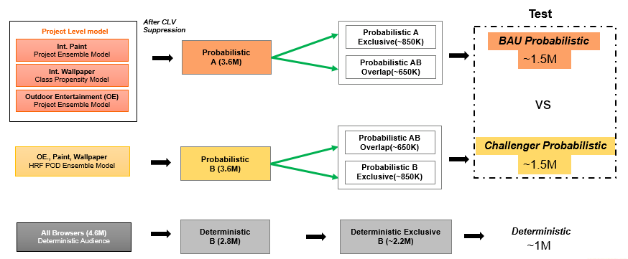
Existing (HRF) – Pod vs Project | Test and Measurement Summary
HRF – Pod vs Project
Test whether Targeting HHs using a unified pod-level model is more effective than the approach of aggregating households from individual project models within the pod
Test the Pod model vs Project model (Ensembled from individual projects)
What
Why
How
Test Plan
Objective
Test-plan
Insights
Results
Performance Metrics
Insights:
The audiences from the new challenger model has a higher Enterprise and In-class Conversion Rate and Sales/HH
Recommendation :
Leverage the New Challenger Model to identify Home Refresh Probabilistic audiences and apply learnings to Home Maintenance
HRF - Group | Targeted base | Conversion | Sales/HH Targeted
Challenger | 1.7 M | 66.76% | $ 194.09
BAU | 2.4 M | 48.30% | $ 113.96
Challenger | 1.7 M | 21.66% | $ 67.17
BAU | 2.4 M | 14.61% | $ 64.67
Enterprise
In-class
Challenger – pod model , BAU – ensembled project model
Test period - FW 27-30

Slide 12

Existing – Multiclass | Model summary
Validation Approach
Group A
HRF
HRF ( Top 4 M)
To identify the Next Best Action for households across HMN, HRF and No Purchase maintaining exclusivity
Vs
HMN
₊
Rnk(HRF >= HMN) ( Top 4M )
Multiclass Model
Group B
Compare the Multiclass model vs BAU approach (POD level Model) with Out of Time Validation
₊
Rnk(HMN >= HRF)
HMN ( Top 4 M)
HMN
Vs
What
Why
How
Test Plan
HRF
₊
₊
Rnk(HMN >= HRF) ( Top 4M )
Rnk(HRF >= HMN)
Objective
Validation Approach
Out of Time Validation
Insights
Results
Insights:
Multiclass Model shows 0.6% better conversion for Home Refresh
POD level model performs better for the sales KPIs for both the PODs
Recommendation :
Multiclass Model might act for audience governance but cannot replace existing pod level models
Model Performance Metrics
Group | Conversion | Sales/HH Targeted
HMN – POD | 23.90% | $ 26.94
HMN - MULTICLASS | 20.51% | $ 20.84
HRF – POD | 16.90% | $ 25.50
HRF - MULTICLASS | 17.50% | $ 24.55
In-class
* Metrics for the month of Feb

Slide 13
FY24 Q4 – Summary
& A/B Test Results

Slide 14

Existing – XGB vs LSTM | Test and Measurement Summary
LSTM vs XGB
To assess whether the LSTM model is better in identifying purchasers and drives better sales compared to the XGB (Pod model)
Audience captured through XGB model
Existing Audience
Overlap
Measurement
Test the BAU Pod model (XGB) vs
Challenger (LSTM)
What
Why
How
Test Plan
Audience captured through LSTM model
* Only sales features
Objective
Test-plan
Insights
Results
Performance Metrics
Insights:
Challenger model (LSTM) performed better in terms of Conversion rates but poor with Sales/HH targeted for both Home maintenance and Home refresh at enterprise and in-class
Recommendation:
Continue with the pod model for the audience selection process
Group | Targeted base | Conversion | Sales/HH Targeted
HMN - Challenger | 1.7 M | 67.23% | $ 178.40
HMN - BAU | 1.5 M | 66.45% | $ 227.18
HRF - Challenger | 1.6 M | 61.18% | $ 151.49
HRF - BAU | 1.6 M | 60.04% | $ 154.80
Enterprise
Challenger – LSTM model , BAU – Pod model
Test period - FW 40-44

Slide 15
Existing – Single vs double exposure | Test and Measurement Summary
Single exposure vs Double exposure
Test if targeting households for both HMN AND HRF campaigns yields better performance than targeting them only for one
Audience selected for HMN campaign
Overlap audience who receives both the campaigns
Existing Audience
Test the audience performance for single exposure versus double exposure in each pod
Measurement
What
Why
How
Test Plan
Audience selected for HRF campaign
Objective
Test-plan
Insights
Results
Performance Metrics
Insights:
Audiences exposed twice generally outperform those exposed once in terms of conversion and sales per targeted household
Recommendation :
To maximize conversion and sales, having double exposure audience for both the campaigns is advisable, rather than limiting the exposure to just one
HRF - Group | Targeted base | Conversion | Sales/HH Targeted
HMN – SINGLE | 2.8 M | 59.33% | $ 161.41
HMN - DOUBLE | 2.4 M | 64.84% | $ 202.94
HRF – SINGLE | 2.8 M | 50.64% | $ 109.92
HRF - DOUBLE | 2.4 M | 64.84% | $ 201.27
Enterprise
Single exposure vs Double exposure
Test period - FW 40-43

Slide 16
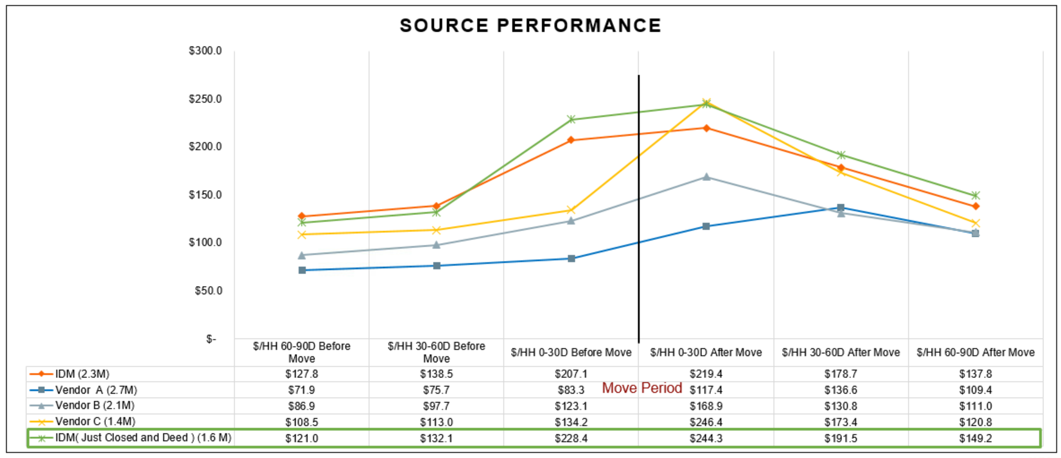
Existing – Movers Source assessment | Summary
The assessment of third-party (3P) data sources allows the business to identify and target movers more effectively, optimizing engagement and conversion opportunities.
Data sources : IDM , Porch , NCOA, Core-logic
* Vendor A – Porch
* Analysis period : Jan 2024 to June 2024
Insights :
Among the other data sources that IDM having just closed and deed provides a better understanding of movers
Porch among the other data sources seems to be less efficient in capturing the Movers trends
>> IDM Source Assessment Updated.pptx <<

Slide 17
FY25 Q1 – A/B Test
Frameworks

Slide 18
Existing – Overlap (HMN/HRF) | A/B Test framework
To determine for which creative households are most likely to engage and convert from.
Our business partners need
To better identify those households who are more affined towards specific creative.
Additionally, they want to optimize creative allocation by understanding which segments drives the highest engagement and conversion, ensuring more effective targeting.
Evaluate household conversion rates and $/HH across three creative segments: HMN, HRF, a combination of both (HMN&HRF)
What
Why
How
Test Plan
What
Why
How
Test Plan
Overlap Audience Test – FW 09
HMN Pipeline 4M
~3.5M Model prediction
+
~ 6M Browsers
HMN Exclusive
(A)~2M
HMN ~660k
HRF Exclusive
(B)~2M
HMN Single Exposure
~660K
HRF Pipeline 4M
~3.5M Model prediction
+
~ 5M Browsers
Overlap of HMN
& HRF ~2M
Measurement
Overlap
(C)~2M
HRF Single Exposure
~660K
HRF ~660k
Double Exposure
~660K
Both ~660k
Note:
For HMN & HRF a total of 4M audiences will go live for each week
The A/B test is done only for the overlap audience between HMN & HRF Sub pods.

Slide 19
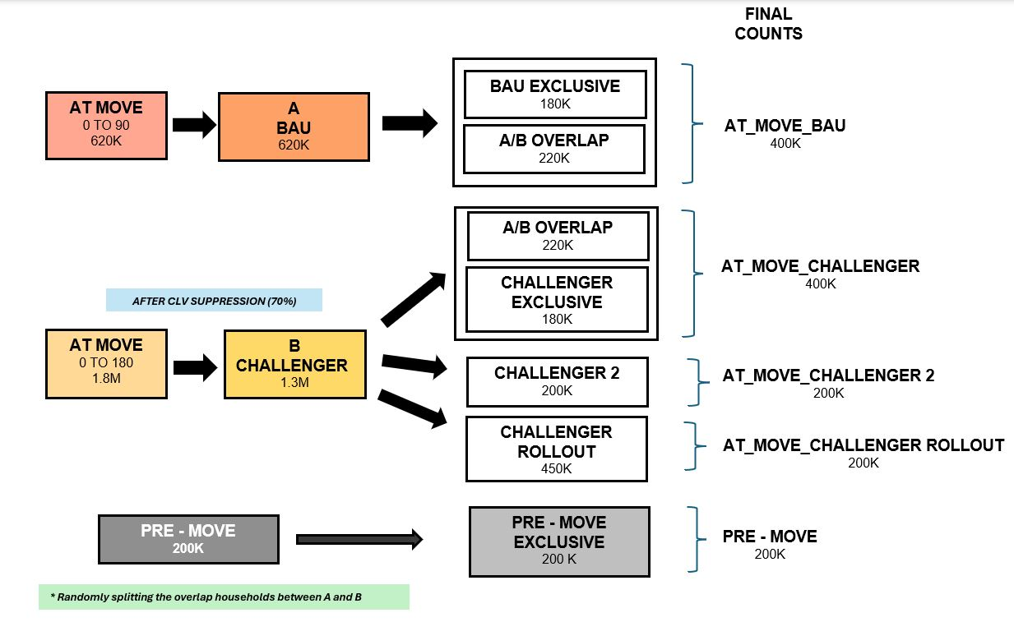
Existing – Movers (At-move time frame) | A/B test framework
To determine for which time period would better define the At-move segment
Our business partners need
They want to chose the best time-frame by understanding which period drives the highest engagement and conversion, ensuring a better definition of the at-move segment
Evaluate household conversion rates and $/HH across At-move with two different time periods : ( 0 to 90 days ) vs ( 0 to 180 days )
What
Why
How
Test Plan
What
Why
How
Test Plan
Test – 2025Q1
Total HHs : 1.5M
AT_MOVE_BAU
~400k
AT_MOVE
( 0 – 90 days )
Measurement
AT_MOVE_CHALLENGER
~400k
AT_MOVE
( 0 – 180 days )

Slide 20



Existing – HMN & HRF | Audience selection process flow
Audience selection for HMN and HRF
Movers & Pro removed from the existing audience base ~ (35M-40 M)
Deterministic Audience
.
Browse signals from guides, PIP-PLP, leads, quotes, and keywords.
Combined Deterministic Audience based on HH_id
Final Audience Base
.
HMN - 4 M
HRF - 4 M
Audience base
Audience Prioritization & CLV Suppression
Probabilistic Audience
From the model predictions
Audience Priority Flags
Overlapped Audience ( Det + Prob )
Probabilistic Audience
Deterministic Audience
CLV suppression
Suppressing the bottom 30% CLV audience
Model Scoring Pipeline
Audience Selection
Deterministic audience based on the past 30 days browse signals
Probabilistic audience based on the R12 behavior
Feature Mart
Spend, page visits, and transactions at both class and sub-class levels, demographic information, enterprise spend, and prior campaign data.
Project doers : a minimum purchase in one anchor class
Stage 1 - Propensity model
Propensity - probability of purchase in next 30 days
Revenue model - revenue spend in the next 30 days
Ensembled Score – product of propensity and revenue scores
Model Features
Project Ensembled Score
Stage 2 - Revenue model

Slide 21



Future – Prospects | Audience selection process flow
Audience segment consisting of individuals highly likely to make their first purchase at Home Depot. This group is identified using 2P and 3P data, browsing behavior, and demographic insights across various customer segments.
Source table : Customer INDV
( HH where all ECRs are prospects and age <= 43)
Neustar data
Source table : crm_browse_overlay
(Adding browse details for the past 6 months)
Selecting the top prospects based on their propensity scores
Selecting the audience by different profiles
Capturing browse signals & housefacts for the prospects
Creating the final audience with segments on generation, homeowner
Selecting audience
Source table : Housefacts_AMA
(housefacts for the prospects)
Source table : Customer_demo_e1
(Audience based on different profiles based on demographics and different purchase pattern -stores,home/garden/internet.. )
Audience targeted weekly
~ 3.5 M ( Prospects )
Prospect Homeowners: Defined by Neustar data , Generational flag : Segmented based on their age

Slide 22
Existing - Movers | Audience selection process flow
Movers : Individuals who are moving or will be moving to their new homes often require packing/transportation, to set up their belongings in their new homes identified by 3P data sources
Audience selection for Movers
Combined At-move
( Using figl3id )
Pre-Move
(List_date,List_days)
Movers Persona
Creating persona with the data from Neustar and core logic
and removing the opted-out audience
At-move
( If move date in past 90 days )
Porch, Core Logic, IDM, NCOA
Removing Pre-movers from At- Movers using
( HH id, figl3id )
Removed overlap with multiple sources & have combined source
HH_id Mapping
Remove the lapsed/inactive Audience and selecting existing consumers
3P_Data ordered by priority
Porch : Inspection date ( Pre-move : 0-42 days , At-Move : 42-133 days from current date )
Core Logic : Close date ( At-move : close date )
( pre-move : active date, contingent date within 3 months )
IDM : File date ( Pre-move : 3 months prior to move date , At-move: next 3 months after date)
NCOA : File date ( Pre-move : 3 months prior to move date , At-move: next 3 months after date)
Approach
Mapping fig3lid with HH_id
( If two HH_ids share the same fig3lid, select the one with the highest sales, ordered by (CY, LY))
Movers Audience
~ 1M
Terms
List Date: The date when a property was listed for sale on the market.
Close Date: The date when the property transaction is officially completed, and ownership is transferred to buyer

Slide 23
Appendix

Slide 24
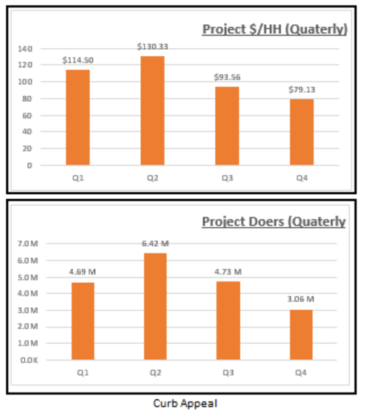
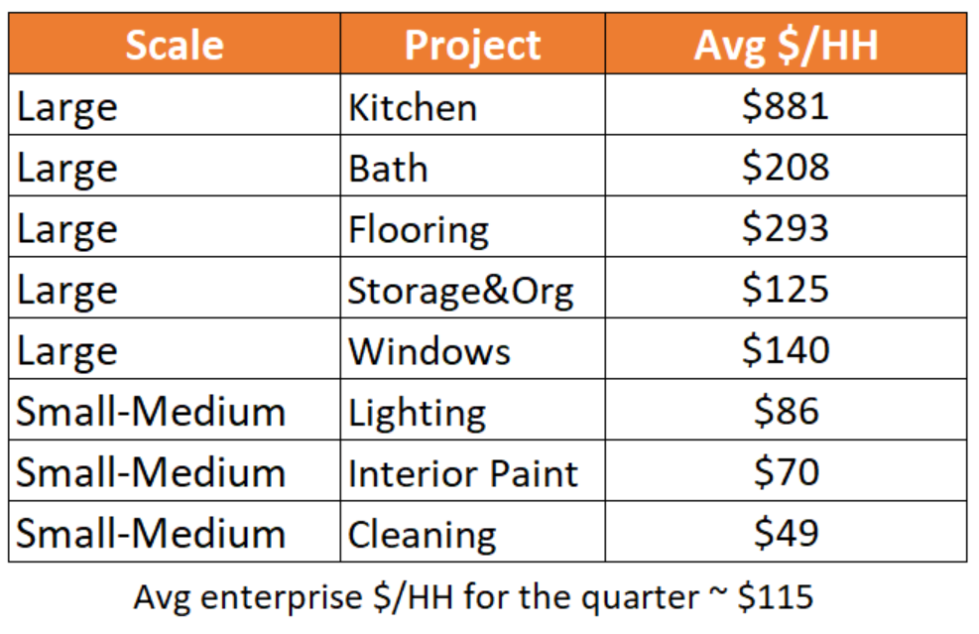
Existing | Project calendar
Project is defined as a purchase combination consisting of a set of anchor classes and relevant classes.
Anchor classes are core product categories that define the project (e.g., bathtubs, toilets, and seats are anchor classes for bath project),
while Relevant Classes include additional related categories (e.g., countertops, pipes, and fittings are relevant for bath) that complement the project.
Metrics : Project doers, Sales, AOV, Wallet share ..
Selecting projects for HMN/HRF
Project Segmentation
Spend per HH index ~ (project $/HH)/(quarter $/HH)
If spend per HH index is > 1 then large project else medium-small project
Project performance for the R12 period
Selecting the top performing projects for each quarter
Project-product mapping
Project doers : a minimum purchase in one anchor class
Project types
Large/Small-Medium Scale: A project is large if its spend per household exceeds the enterprise average for the quarter.
Seasonal/Year-Round: Projects with peaked metrics in specific quarters are seasonal; consistent metrics classify them as year-round.
Ex- Curb appeal shows high seasonality in Q2

Slide 25
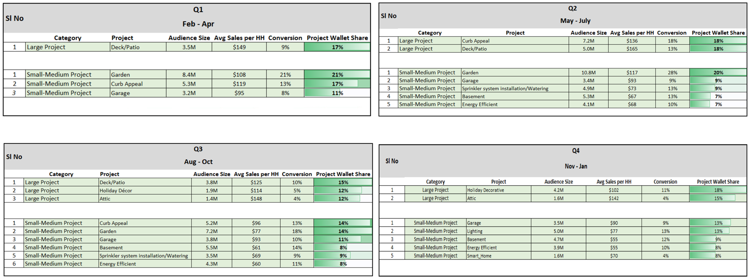
Wallet share : Project sales / Enterprise Sales
*Timeframe considered R12 from 2023-07-30

Slide 26
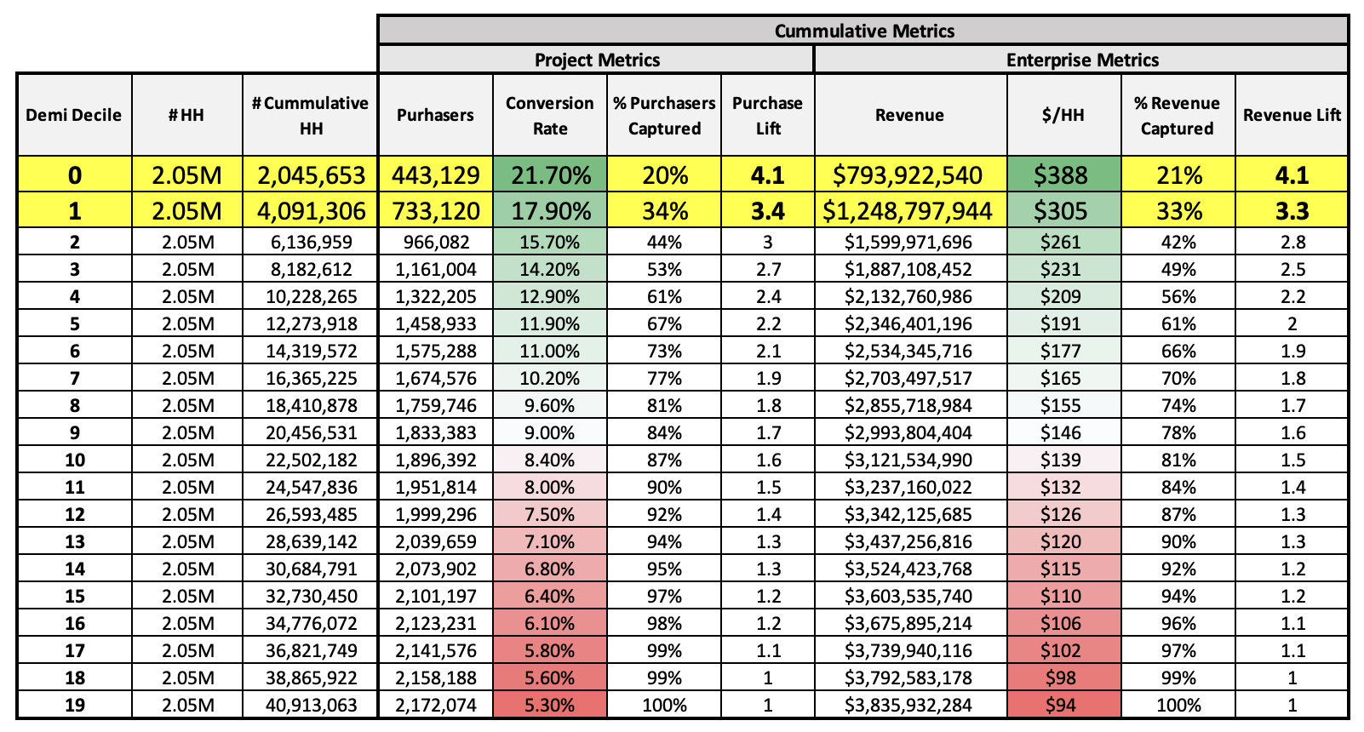
Sample - OOT Validation
What is Lift?
Lift is a measure used to evaluate the performance of a model. It helps understand how much better a model is at predicting outcomes compared to a random guess.
In the case of the Garden Model, selecting the HHs
from the top demi-decile will have 4X conversion rate and 4X Spend compared to a randomly selected 2M audience

Slide 27




Sample features : Project - Garden
Past Sales Variable | Recent 30 day to 12 months of transaction and/or spend variables at enterprise level & for classes - Live Goods, Soil & Amendments, Seeds, Fertilizers
Demographic Variable | Customer and House Demographic Variables like -, TSI Segments, HH Age, Home Value, HH Occupation, Dwelling Unit Size, etc.
Browse Variables | Customer Page Visits in the last 7/ 14/ 21/ 30/ 60/ 90 days for classes like - Fertilizers, Grills, Storage devices, Wet Dry Vacs, Wiring Devices, Insulation
Past Campaign Targeting | Previous marketing campaigns that the customer was a part of – Count of all or base funded community campaigns in last 1/4/3 weeks.
Features
part of the
Propensity Model

Slide 28
Existing (HRF) – Pod vs Project | Test plan
Test
After CLV
Suppression
Project Level model
Probabilistic A
Exclusive(~850K)
Int. Paint
Project Ensemble Model
BAU Probabilistic
Probabilistic
A (3.6M)
~1.5M
Probabilistic AB Overlap(~650K)
Int. Wallpaper
Class Propensity Model
Outdoor Entertainment (OE)
Project Ensemble Model
vs
Probabilistic AB Overlap(~650K)
Challenger Probabilistic
OE., Paint, Wallpaper
HRF POD Ensemble Model
Probabilistic
B (3.6M)
Probabilistic B
Exclusive(~850K)
~1.5M
All Browsers (4.6M)
Deterministic Audience
Deterministic
B (2.8M)
Deterministic Exclusive
B (~2.2M)
Deterministic
~1M

Slide 29
FINAL COUNTS
BAU EXCLUSIVE
180K
AT MOVE
0 TO 90
620K
A
BAU
620K
A/B OVERLAP
220K
AT_MOVE_BAU
400K
A/B OVERLAP
220K
CHALLENGER
EXCLUSIVE
180K
AT_MOVE_CHALLENGER
400K
AFTER CLV SUPPRESSION (70%)
AT MOVE
0 TO 180
1.8M
B
CHALLENGER
1.3M
CHALLENGER 2
200K
AT_MOVE_CHALLENGER 2
200K
CHALLENGER
ROLLOUT
450K
AT_MOVE_CHALLENGER ROLLOUT
200K
PRE - MOVE
200K
PRE - MOVE
EXCLUSIVE
200 K
PRE - MOVE
200K
* Randomly splitting the overlap households between A and B

